Slide 1

IQ 3D PRINTING CORE
The 3D Printing Core empowers you with an array of cutting-edge 3D printing solutions, catering to a vast array of materials including plastics, metals, and living materials (cells & bacteria). Our unrivaled versatility extends across an impressive spectrum of dimensions, encompassing nanometer precision all the way up to grand scales. With us, you unlock boundless potential for turning your boldest visions into tangible reality.

Slide 2

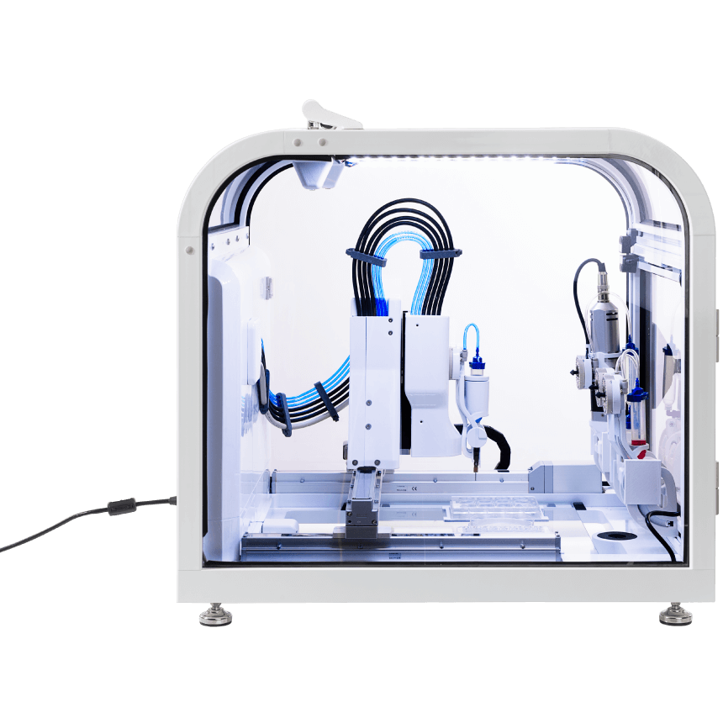
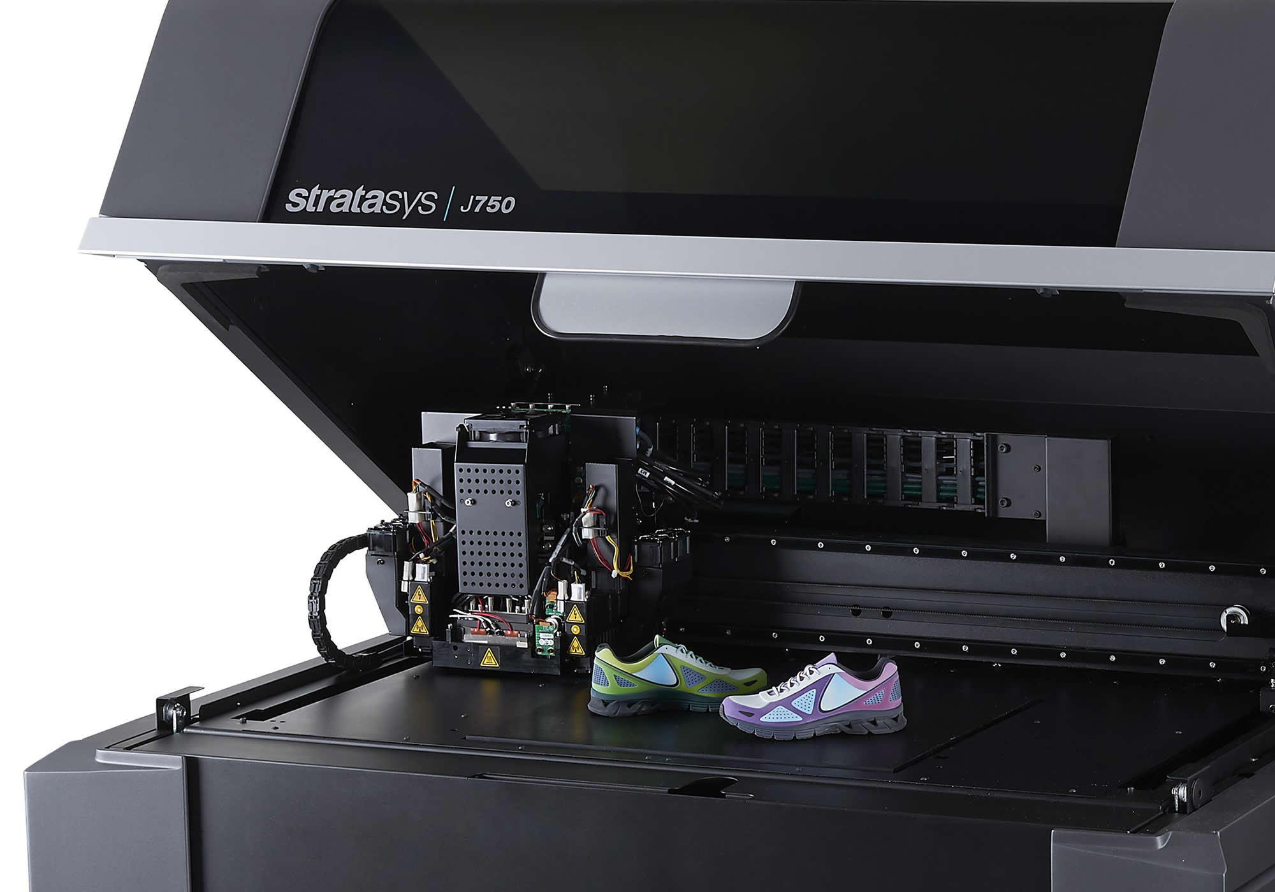
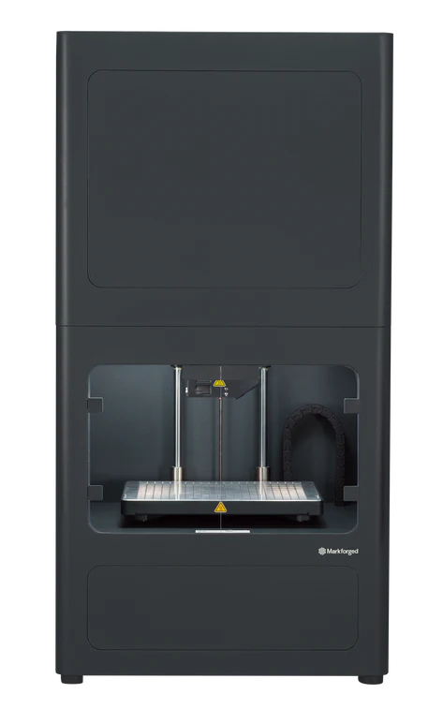
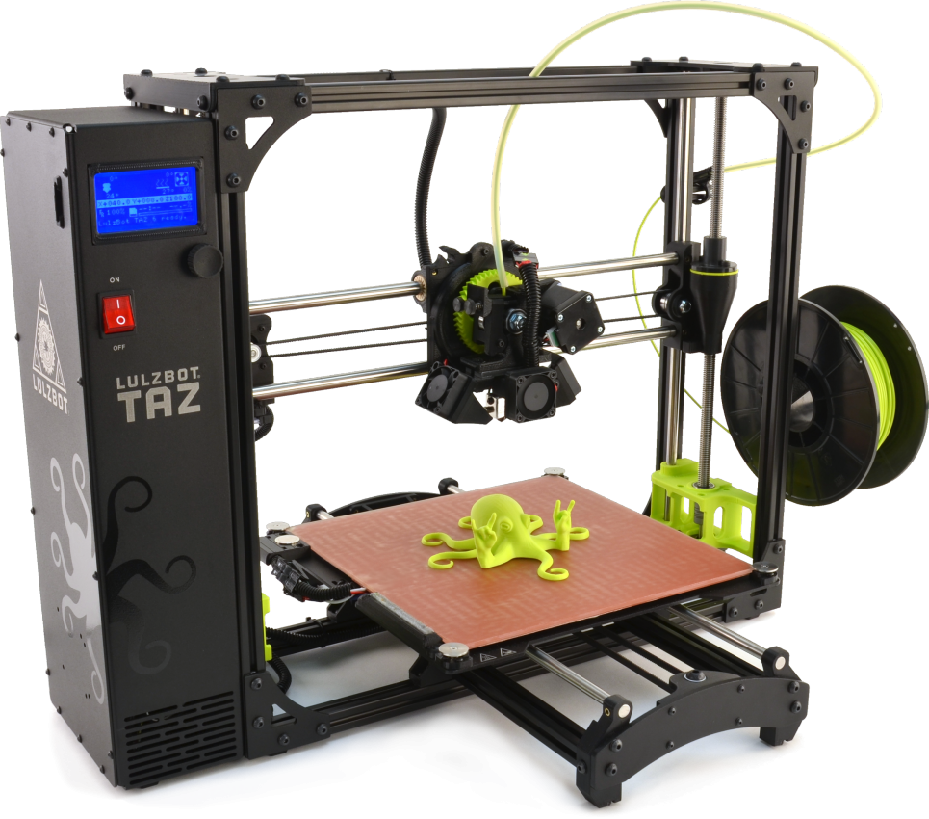
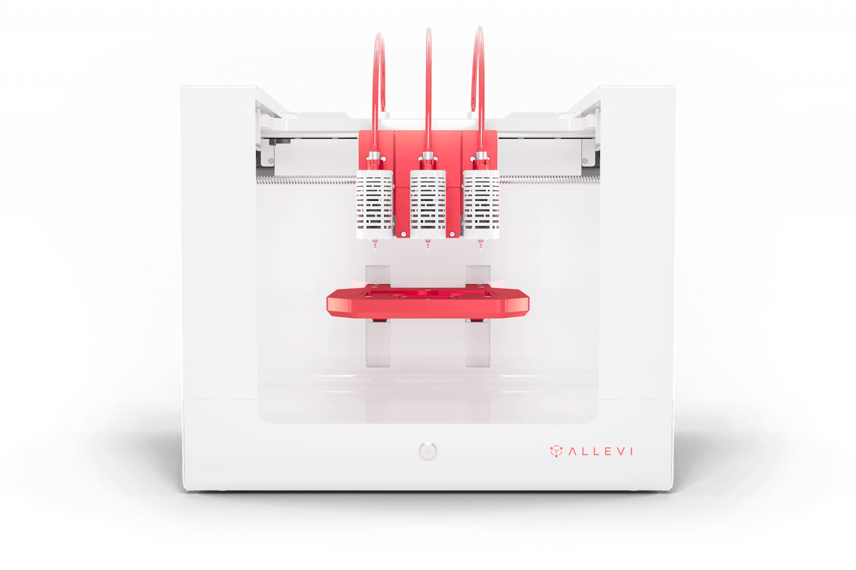
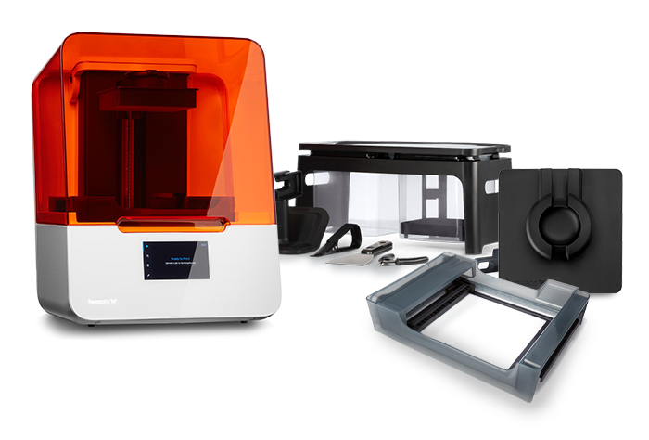
3D Printers
Nanoscribe Quantum X bio
Brinter ONE
STRATASYS J750
Markforged Metal X
Allevi 3 Bioprinter
LulzBot TAZ 6
Formlabs Form 3B+

Slide 3
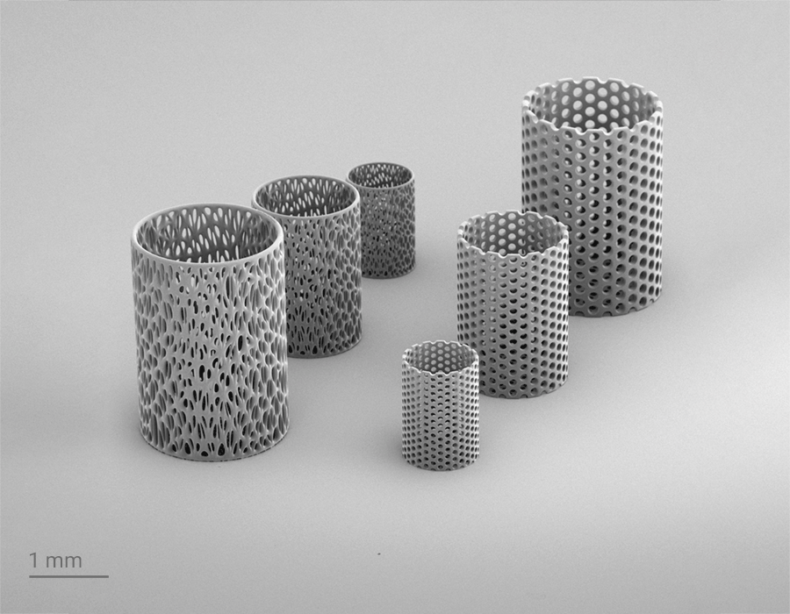
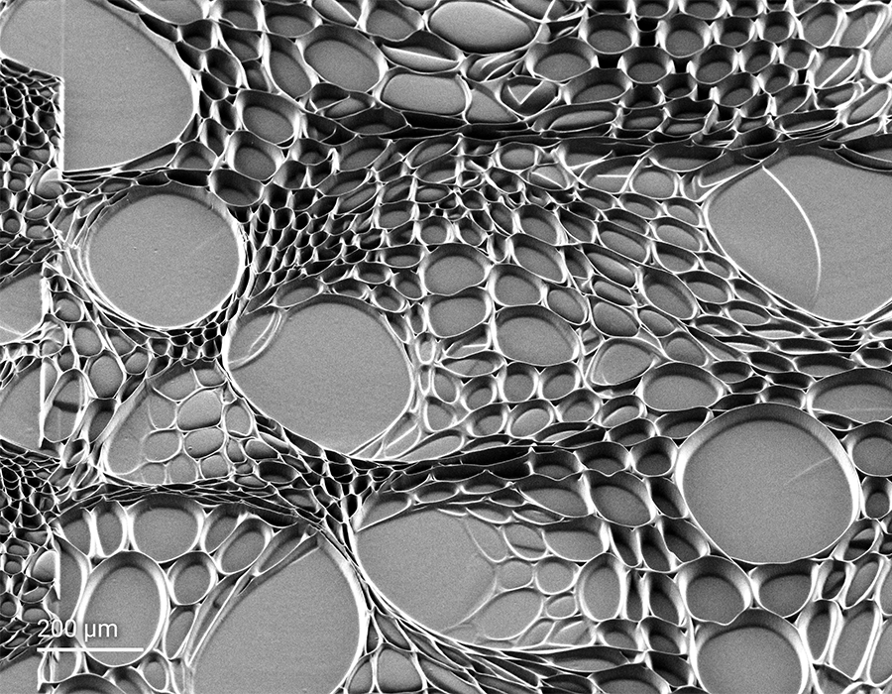
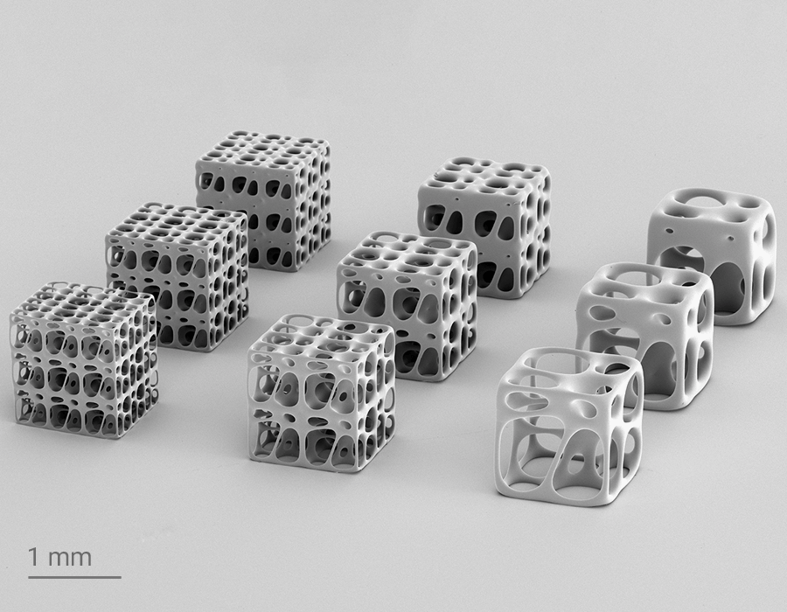
Nanoscribe Quantum X bio
(Start 2024)
Description:
The world’s most accurate 3D bioprinter enables a diversity of biological and biomedical applications with a wide choice of biocompatible materials, both synthetically made and naturally derived.
Link:
Quantum X bio: our new high-precision 3D bioprinter (nanoscribe.com)

Slide 4
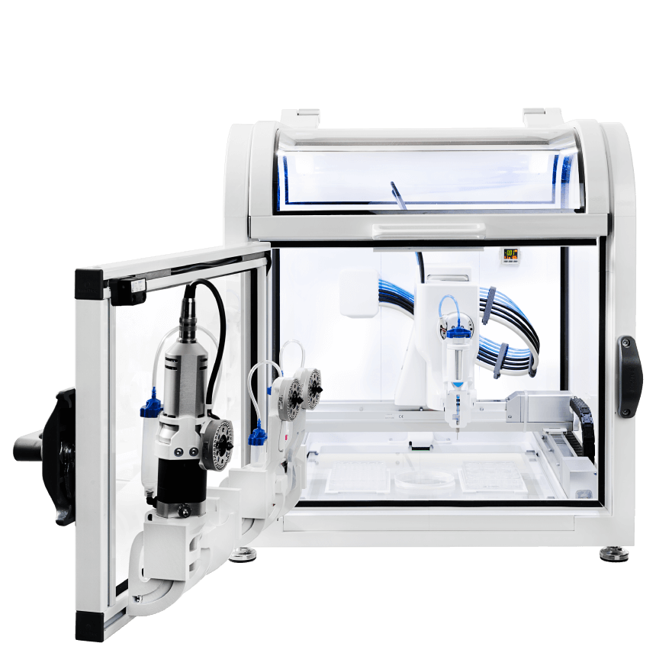
Brinter ONE
Description:
A modular 3D bioprinter platform offering variable printing modalities in a single printing platform. Print unlimited number of print materials
Link:
Brinter ONE - Multitool 3D Bioprinter

Slide 5
Allevi 3 Bioprinter
The Allevi 3 bioprinter empowers you to print any cell line, into a variety of geometries for a broad range of applications. Allevi 3 will exceed your needs today and has the versatility to grow with your work.
Designed and optimized for research in:
Tissue engineering
Materials science
Regenerative medicine
Disease modeling
3D culture
Organ-on-a-chip
Microphysiological systems
Drug delivery
Link:
Allevi 3 - Allevi (allevi3d.com)

Slide 6
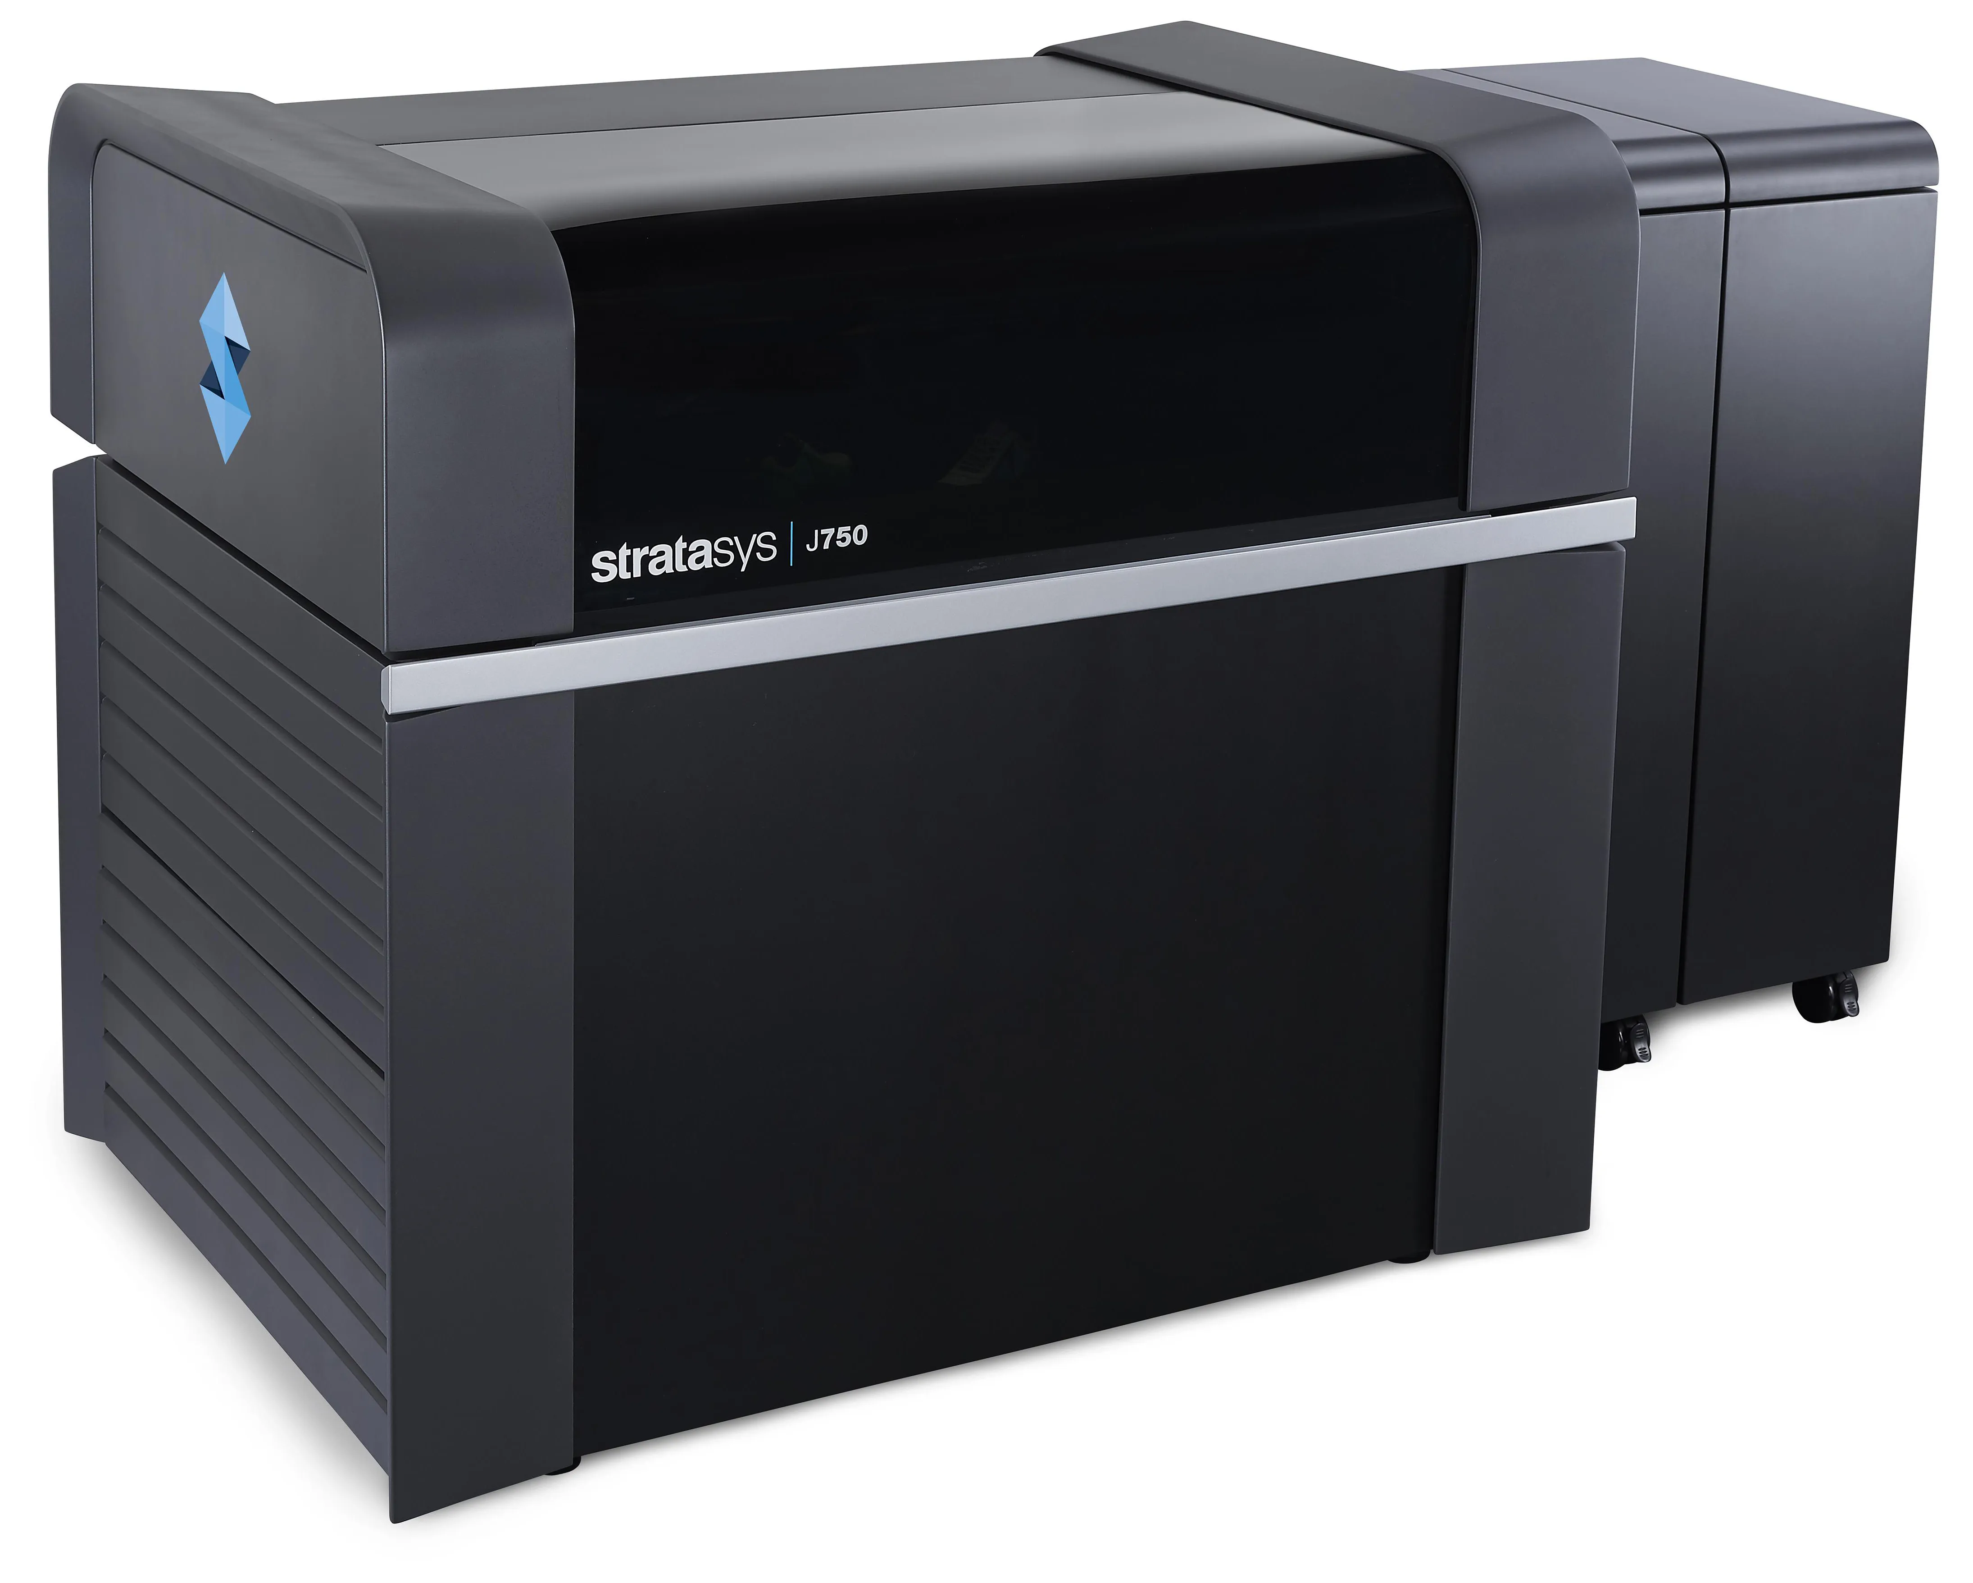

STRATASYS J750 3D PRINTER
Description:
The Stratasys J750 Printers is the only printer able to produce the boldest full color, multi-material parts in a single print. This full-color multi-material 3D printer combines imaging, ingenuity, research and resolve to the additive manufacturing market. Your team will be able to model and 3D print the most complex prototypes and parts possible. Utilize the accuracy, reliabiility, precision and repeatability that you have come to expect from Stratasys 3D printers. Industries such as; medical, aerospace, consumer goods and high-tech rely on the versatility of the Stratasys 750 3D printer for their additive manufacturing and prototyping needs.
Link:
Stratasys J750 & J735 Full Color 3D Printers | GoEngineer

Slide 7
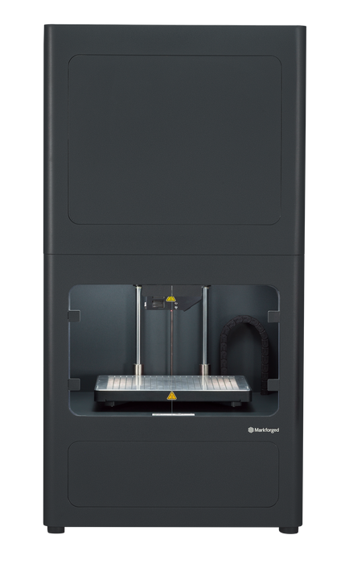
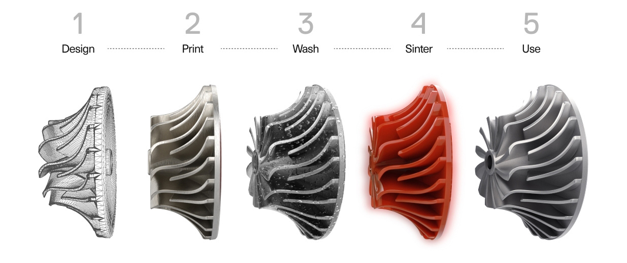
Markforged Metal X 3D Printer
Description:
The Metal X System is an accessible way to fabricate complex metal parts in a wide variety of advanced metals.
Link:
Markforged Metal 3D Printer: The Metal X 3D Printing System

Slide 8
LulzBot TAZ 6
Description:
The LulzBot TAZ 6 is the most reliable, easiest to use desktop 3D printer ever, featuring innovative self-leveling and self-cleaning, and a modular tool head design for flexible and multi-material upgrades. With proven 3D printing technology and one of the largest print volumes in its class, the LulzBot TAZ 6 is ready to work.
Link:
LulzBot | Taz-6-product-page

Slide 9

Formlabs Form 3B+
(currently Li Lab)
Description:
Rapidly print patient-specific parts at the point of care and bring innovative R&D and commercial production in-house with the Form 3B+, an advanced 3D printer for healthcare professionals and medical device engineers.
Link:
Form 3B+: An Advanced Desktop 3D Printer Designed for the Healthcare Industry | Formlabs

